Slide 2
Notes:
Speaker Notes This is a summary of what we’ll be talking about today.

Slide 3
Notes:
Speaker Notes
Cervical cancer was once one of the most common causes of cancer death for women in the U.S. The cervical cancer death rate dropped by over 50% in recent decades with the increased use of screening. The numbers are clear—screening saves lives. This presentation will go over all you need to know to see for yourself if you’re up to date with your knowledge of cervical cancer and how to get screened.

Slide 4
What causes cervical cancer?
Notes:
Speaker notes:
What causes cancer in this tissue? Let's find out.

Slide 5
What is the cervix?
Notes:
Speaker Notes
First, let's describe what the cervix is. The cervix is the lower part of the uterus (womb) that connects to the to the vagina (birth canal).

Slide 6
Cervical cancer begins with abnormal cells
Notes:
Speaker notes:
Cervical cancer occurs when the cells of the cervix develop the ability to grow out of control and out of sync with the rest of the tissues in your body. Cervical cancer is dangerous because it can develop the ability to invade and damage other tissues.

Slide 7
What are pre-cancers?
Notes:
Speaker notes:
To understand the basis for cervical cancer screening, it’s important to learn about pre-cancers. So, what are pre-cancers?
Before cervical cancer develops, the cells of the cervix undergo specific changes that can be identified by screening. These changes are called pre-cancers.
Pre-cancers themselves are usually asymptomatic, so no one would know they had pre-cancers without screening. The good thing about pre-cancers is that they can be treated to prevent cervical cancer from developing. Identifying pre-cancers through screening and treating them is the reason that screening has saved so many lives from cervical cancer.

Slide 8
What causes cervical cancer?
Notes:
Speaker notes:
Next, what causes cervical cancer? Unlike most cancers, we have a simple answer to this cancer. The virus Human papillomavirus, or HPV, causes almost all cases of cervical cancer. There are many types of HPV, some which cause warts, some which cause cancer, and many varieties that cause no symptoms at all in most people. HPV can be passed from one person to another during skin-to-skin contact. One way HPV is spread is through sex, including vaginal, anal, and oral sex. Most people who have HPV will never have any symptoms.

Slide 9
HPV Infection
Notes:
Speaker notes:
HPV is incredibly common. Almost everyone who’s been sexually active has been exposed to HPV. Luckily, in the majority of cases, your body will rid itself of the infection all on its own—and you’ll likely never experience any symptoms. However, in a small percentage of cases, your body doesn’t clear HPV on its own. These are the infections that put people at risk for developing cancer. Luckily, with screening HPV infections and pre-cancers can be identified and treated so that cervical cancer doesn’t develop.

Slide 10
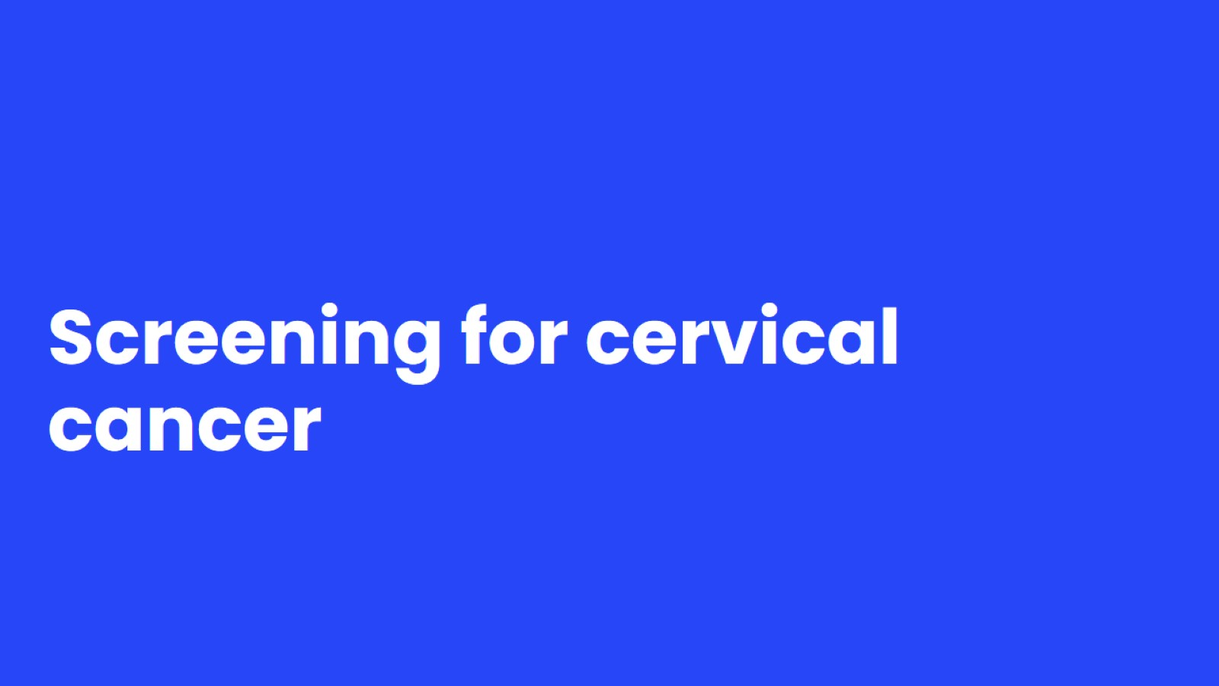
Screening for cervical cancer
Notes:
Speaker notes:
Now that we’ve covered the cervical cancer basics, let dig a bit deeper into cervical cancer screening.

Slide 11
What is cervical cancer screening?
Notes:
Speaker Notes
So what is cervical cancer screening?
In general, screening is testing to find cancer, or other diseases, in people who have no symptoms. For cervical cancer, screening can find pre-cancerous changes that can be treated to prevent cancer from developing. Screening can also help find cancers when they are small and have not spread – when they may be easier to treat.

Slide 12
What does cervical cancer screening entail?
Notes:
Speaker notes:
What does cervical cancer screening entail? Your health care provider will do a pelvic exam and will insert a small brush or swab into the vagina and collect cells from your cervix for testing.

Slide 13
Types of cervical cancer screening tests
Notes:
Speaker Notes
HPV Test: A test which collects cells from the surface of the cervix to check for HPV
The cells are collected during a pelvic exam using a small brush or swab, then sent to a lab for testing. Doctors can test for the high-risk HPV types that are most likely to cause cervical cancer by looking for pieces of their DNA in cervical cells.
Results can help the doctor decide if more testing is needed
Pap test: Similar to a primary HPV test, a Pap test also collects cells from the surface of the cervix.
These tests can be done alone or at the same time (called a co-test) and are done during a pelvic exam.
The ACS recommends primary HPV testing as the preferred test for cervical cancer screening. Research evidence shows that primary HPV testing is more efficient than co-testing and more effective than Pap testing alone. However, screening using any method is effective in identifying people at risk for cervical cancer.

Slide 14
Notes:
Speaker notes:
Screening for cervical cancer is recommended for individuals with a cervix starting at age 25 years. This is because cervical cancer before age 25 is extremely rare.
For individuals aged 25 to 65 years, screening should be done every 3-5 years depending on the type of testing that is done. Your health care provider will advise you how often to get screened based on your screening history.
Individuals older than 65 years who have had regular screening with normal results should not be screened for cervical cancer. Once screening is stopped, it should not be started again.
Individuals who do not have a cervix (for example, because of a hysterectomy) and who do not have a history of cervical cancer or a serious precancer should not be screened.
Speaker directions:
If asked about starting at 25 - Less than 1% of cervical cancer deaths are in women who were diagnosed before each 25. Disease burden was just one of many factors considered that led to the change the starting age for screening.
People who have received the HPV vaccine should still follow age-appropriate screening guidelines.
SOURCES: https://www.cancer.org/cancer/cervical-cancer/detection-diagnosis-staging/cervical-cancer-screening-guidelines.html https://www.cancer.org/cancer/cervical-cancer.html
https://doi.org/10.3322/caac.21820
Diegel RL, Giaquinto AN, Jemal A. Cancer Statistics 2024. Update from the American Cancer Society; CA Cancer J Clin 2024

Slide 15
Possible Screening Test Results
Notes:
Speaker Notes
After cervical cancer screening, you may receive positive or negative results. In this case a negative result means that no HPV infection is present and your cervix looks completely normal. In this case, you’ll be recommended to continue screening at the recommended interval—every 3-5 years depending on the type of test used.
If you get a positive/abnormal result this means that HPV infection was found during screening. As I mentioned previously, HPV infection is extremely common and most infections go away on their own—without any treatment. So, in most cases, your provider will advise you of the result and will have you re-screen in one year to see if the infection has gone away or not. If you have two consecutive positive screening results, your provider may recommend further tests or treatments to prevent cervical cancer from developing.

Slide 16
Preventing cervical cancer
Notes:
Speaker notes: Next, we’ll discuss additional ways you can lower your risk for cervical cancer.

Slide 17
For more information, scan the QR code to visit the Guidelines for the Prevention and Early Detection of Cervical Cancer at cancer.org.
Notes:
Speaker notes:
First and foremost, the most powerful way you can be protected from cervical cancer is by getting the HPV vaccination before age 26. HPV vaccination is most effective when given between ages 9-12. However, since the HPV vaccination is relatively new, many people didn’t have the opportunity to get vaccinated by age 26. In this case, the most important way to lower your risk for cervical cancer is by getting screened at the recommended intervals. Finally, not smoking tobacco is another important way to lower your risk for cervical cancer as smoking is known to double your risk for cervical cancer.

Slide 18
HPV Vaccination and Cancer
Notes:
Speaker notes: We’d be remiss if we didn’t talk about the importance of HPV vaccination. HPV causes multiple other cancers besides cervical cancer. In fact, these days there are more head and neck cancers caused by HPV diagnosed in men in the USA than there are cases of cervical cancer. That emphasizes the importance of getting all genders vaccinated by age 12.
That being said, routine screening for cervical cancer is still necessary for vaccinated individuals. That’s because there are some types of HPV that can cause cancer that aren’t covered by the vaccine.

Slide 19
HPV Vaccination Guidelines
Notes:
Speaker notes: Here are the HPV vaccination guidelines for your reference.
As I mentioned, the vaccine works best between the ages of 9-12. Research shows that younger people have a better immune response to the vaccine than those in their late teens and early 20s. And, the vaccines will prevent the covered types of HPV only if they are given before exposure to the virus.
Teens and young adults age 13 through 26 who have not been vaccinated, or who haven’t gotten all their doses, should get the vaccine as soon as possible. Vaccination of young adults will not prevent as many cancers as vaccination of children and teens.
The HPV vaccine is most effective in early adolescence, but this starts to decrease by age 18. Because of this, it is unlikely to provide much benefit for cancer prevention as people get older which is why the ACS does not recommend that people over the age of 26 get vaccinated against HPV.

Slide 20
Notes:
Speaker notes: This concludes our presentation about cervical cancer and cervical cancer screening. For more information, visit cancer.org or call the number on the screen and speak with one of our cancer information specialists.

Slide 21
Thank you!

